Slide 1
CH-20: Electric Circuits

Slide 2
What we learned so far?
Electric Force
Electric Field
Ch 19:
Electric potential difference (or Voltage)
V is a scalar. SI unit: J/C

Slide 3
Voltage
The energy needed to use a smart phone, for example, comes from batteries.
Within a battery, a chemical reaction occurs that transfers electrons from one terminal (leaving it positively charged) to another terminal (leaving it negatively charged).
Because of the positive and negative charges on the battery terminals, an electric potential difference exists between them. The maximum potential difference is called the electromotive force* (emf) of the battery.
This electric potential difference is also known as the voltage, V.
The SI unit for voltage is the volt, after Alessandro Volta (1745-1827) who invented the electric battery. 1 volt = 1 J/C.

Slide 4
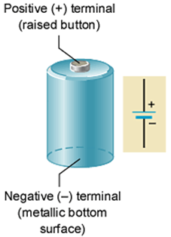
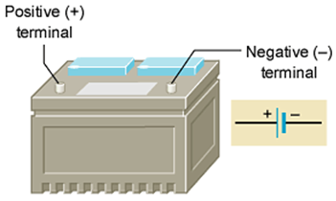
Emf’s or Voltages of Common Batteries
AAA, AA, C, D = 1.5 V
9-volt battery = 9 V
Lantern battery = 6 V
Car battery = 12 V

Slide 5
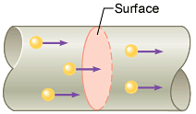
Electric Current
The electric current is the amount of charge per unit time that passes through a surface that is perpendicular to the motion of the charges.
The SI unit of electric current is the ampere (A), after the French mathematician André Ampére (1775-1836). 1 A = 1 C/s. Ampere is a large unit for current. In practice milliampere (mA) and microampere (μA) are used.

Slide 6
Figure 20.6
$$I=nqAV_{d}$$
Free electrons moving in a conductor make many collisions with other electrons and atoms. The path of one electron is shown. The average velocity of the free charges is called the drift velocity, $vd$, and it is in the direction opposite to the electric field for electrons. The collisions normally transfer energy to the conductor, requiring a constant supply of energy to maintain a steady current.

Slide 7
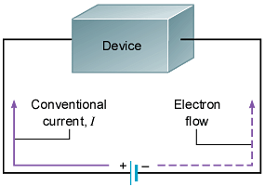
Direction of Current Flow
Electric current is a flow of electrons. In a circuit, electrons actually flow through the metal wires.
Conventional electric current is defined using the flow of positive charges.
It is customary to use a conventional current I in the opposite direction to the electron flow.

Slide 8
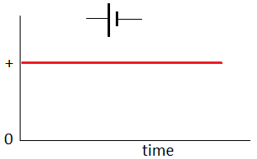
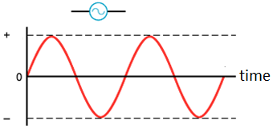
AC and DC
If the charges move around a circuit in the same direction at all times, the current is said to be direct current (dc), which is the kind produced by batteries.
In contrast, the current is said to be alternating current (ac) when the charges move first one way and then the opposite way, changing direction from moment to moment. Outlets give us ac voltage.

Slide 9
Electrical Resistance
When electric current flows through a metal wire there exists a hindrance to the flow, known as electrical resistance.
This is because as the electrons move through they will collide with the atoms of the conductor.
The SI unit of resistance is the ohm (Ω), after Georg Simon Ohm (1787-1854), a German physicist, who discovered Ohm’s law, which will be discussed in the next section.
A resistor is a material that provides a specified resistance in an electric circuit.

Slide 10
Resistance,R and Resistivity,ρ
The resistance of a conductor is directly proportional to the length since the current needs to pass through all the atoms in the length.
The resistance is inversely proportional to the cross-sectional area since there is more room for the current to pass through.
The above observations can be combined and the resistance, R of the conductor is written as follows,

Slide 11
Resistivity of Materials
Resistivity is an inherent property of a material, inherent in the same sense that density is an inherent property.

Slide 12
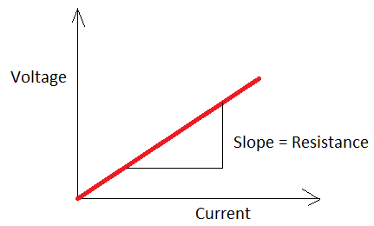
Ohm’s Law
Georg Simon Ohm (1787-1854), a German physicist, discovered Ohm’s law in 1826.
This is an experimental law, valid for both alternating current (ac) and direct current (dc) circuits.
When you pass an electric current (I) through a resistance (R) there will be a potential difference or voltage (V) created across the resistance.
Ohm’s law gives a relationship between the voltage (V), current (I), and resistance (R) as follows:
V = I R

Slide 13
Series and Parallel circuits

